Slide 1
Fluorescence Theory and Fundamentals of Getting Great Data
by Sherry L. Hemmingsen, Ph.D. Molecular Spectroscopy Product Specialist

Slide 2
JASCO Corporation
JASCO Corporation
Hachioji, Tokyo
Since 1958
JASCO, Inc
Easton, MD

Slide 3
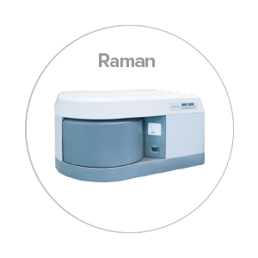
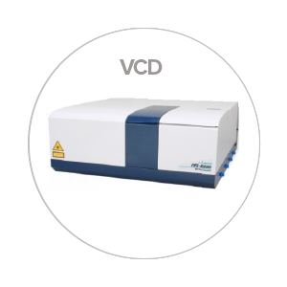
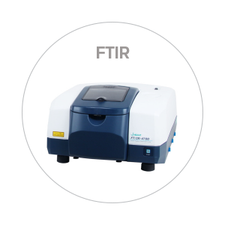
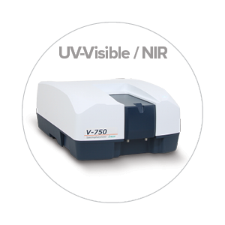
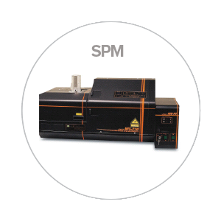
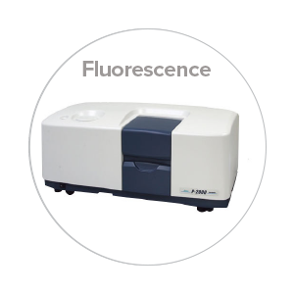
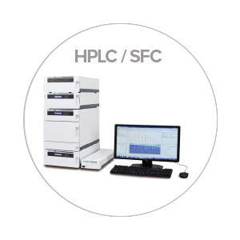
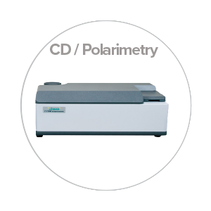
JASCO: Our Products

Slide 4
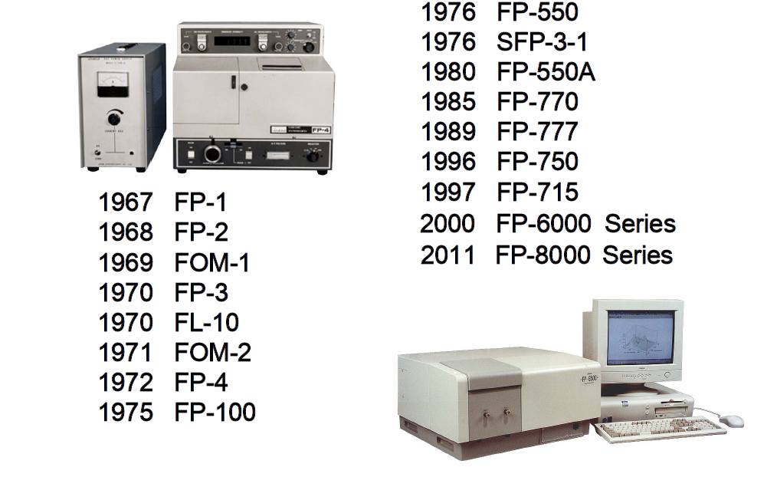
JASCO: > 50 Years in Fluorescence

Slide 5
Seminar Overview
Fluorescence Theory
Electronic transitions and processes of deactivation
Characteristics of fluorescent molecules
Factors that affect fluorescence intensity
Sample, solution, and quantitative considerations
Instrument design and components, and data collection
Practical Pointers for optimizing fluorescence signal
Parameter control
Identifying and minimizing scattering artifacts
Inner-filtering effects

Slide 6
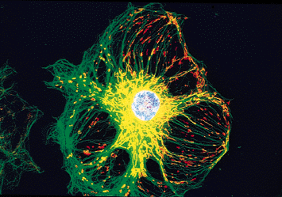
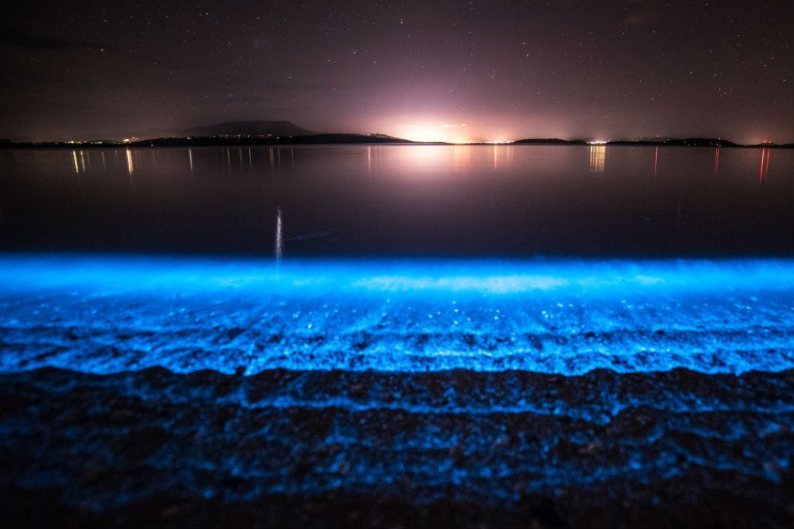
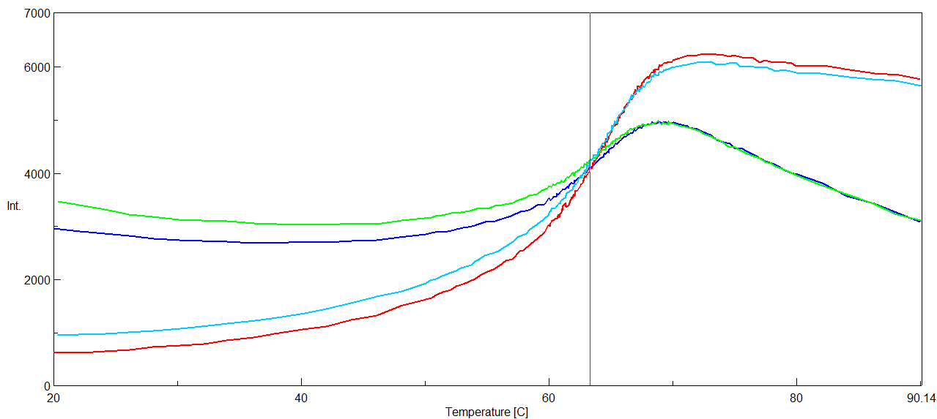
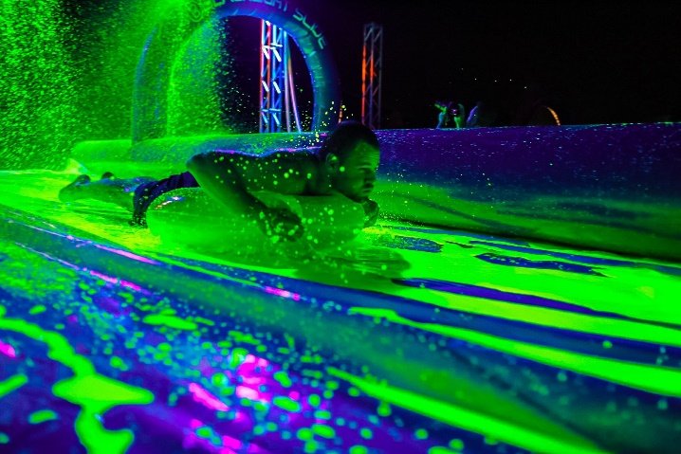
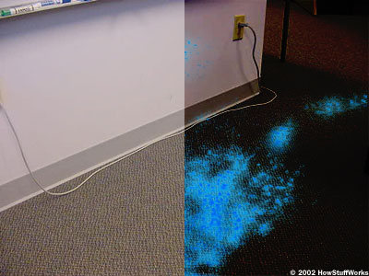
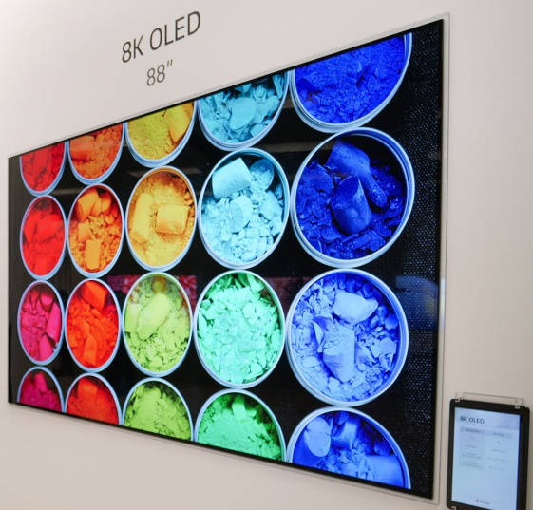
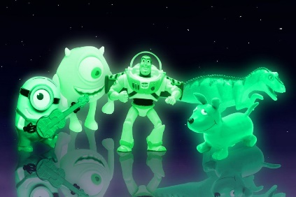
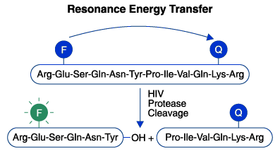
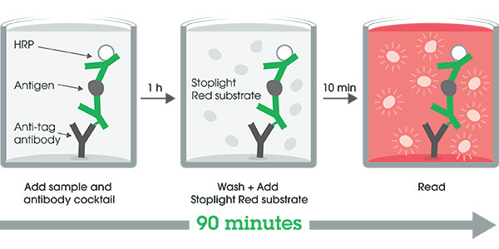
Luminescence Theory
T_{m} = 63 ºC

Slide 7
Fluorescence Applications
Biochemical
Protein folding, drug delivery, binding interactions, aggregation, imaging
Environmental
Pollutant detection / tracking, microbial water testing
Materials Science
Nanoparticles-quantum dots, new material development
Food Science
Ingredient quantitation, antioxidant testing, packaging
And the list goes on…..

Slide 8
Types of Luminescence

Slide 9
How Species Get Rid of Excess Energy
Radiant vs. Nonradiant Energy Loss
Radiative Deactivation:
Emission of excess energy as a photon (UV-Vis, NIR)
Luminescence
Nonradiative Deactivation:
Loss of excess energy without a photon, usually as heat (IR)
Molecular motion

Slide 10
Types of Emission Processes
Photoluminescence: Excitation by absorption of light
Fluorescence ns time regime (lifetime 10⁻¹¹ to 10⁻⁷ secs)
Phosphorescence (lifetime 10⁻³ to 10² secs)
Excitation light source required
Chemi-luminescence: Excitation by chemical reaction
Bio-luminescence: chemiluminescence in a biological system
NO external light required

Slide 11
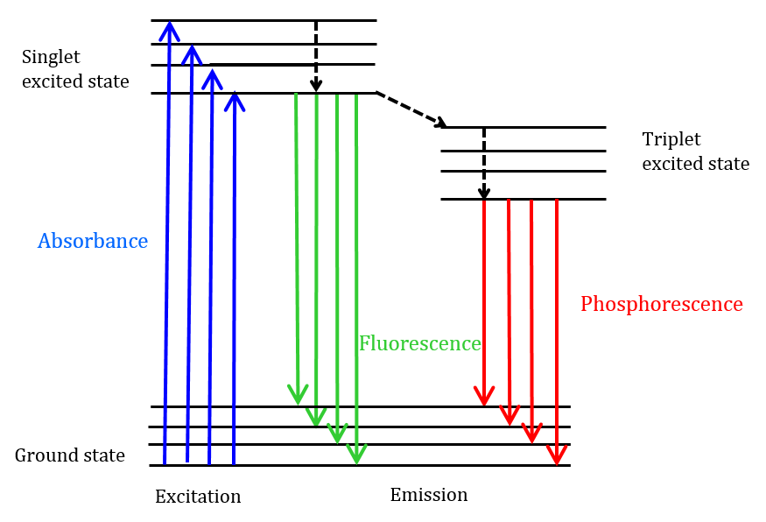
Photoluminescence Processes: Fluorescence
ISC
ISC = InterSystem Crossing

Slide 12
Photoluminescence Processes: Phosphorescence
ISC
Unpaired electron spins
Paired electron spins
ISC = InterSystem Crossing

Slide 13
What Kinds of Substances Fluoresce?
Highly conjugated organic systems (many alternating single and double bonds)
Aromatic molecules
Rigid, planar molecules

Slide 14
Highly Conjugated Systems
Beta Carotene
By NEUROtiker - Own work, Public Domain, https://commons.wikimedia.org/w/index.php?curid=2330317

Slide 15
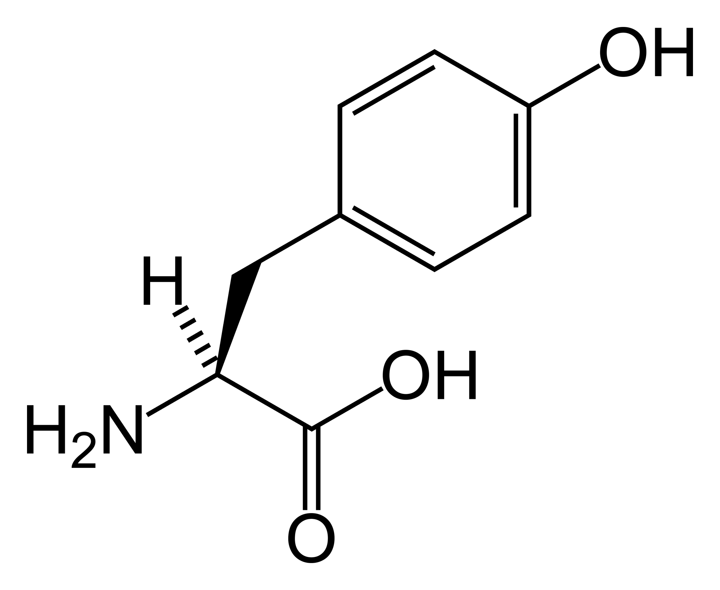
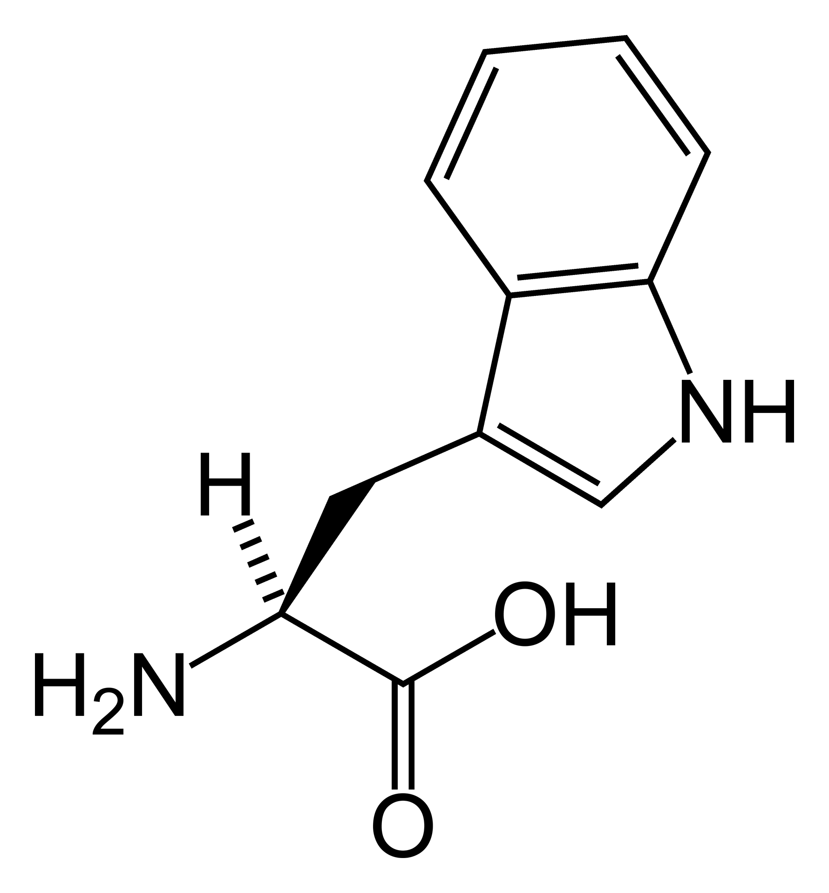
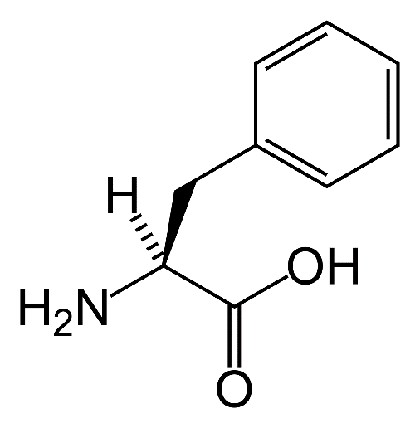
Aromatic Molecules
Tyrosine
Tryptophan
Phenylalanine
Aromatic amino acids provide intrinsic fluorescent probes for studying protein interactions

Slide 16
Rigid, Planar Molecules
Polycyclic Aromatic Hydrocarbons or PAHs
(aka, molecular chicken wire) are highly fluorescent

Slide 17
Your turn….Which molecule fluoresces more?
Biphenyl
Fluorene

Slide 18
How Fluorescent is a Molecule?
Quantum Yield (Quantum Efficiency)
Φ_{F} = # photons emitted as fluorescence
# photons absorbed
values range from 0-1

Slide 19
Your turn…. Which molecule is has the greater quantum efficiency?
1
2
Φ_{F} = 0.90
Φ_{F} << 0.01
Fluorescein
Phenolphthalein

Slide 20
What Factors Affect Fluorescence?
Solution Conditions
Solvent
pH
Ionic Strength
Temperature
Concentration
SOOOOOOOO……
Fluorescence is a highly sensitive tool, especially to local microenvironments around the fluorophore
BUT, this requires careful experimental controls…
This Photo by Unknown Author is licensed under CC BY-NC-ND
This Photo by Unknown Author is licensed under CC BY-SA

Slide 21
Concentration Effects: “low” [ ]’s
F = 2.303 K I_{o} εbc ONLY when 2.303 εbc (= A) < 0.05
K = constant based on instrument geometry
I_{o} = intensity of excitation light
b = pathlength of cell
ε = molar absorptivity of fluorophore
c = concentration of fluorescent analyte

Slide 22
Factors that Increase Fluorescence
Based on the Beer-Lambert equation:
Intensity of excitation light
Different from UV!!!
Molar Absorptivity of Fluorophore
Concentration of Fluorophore
Up to a point before other effects take over…

Slide 23
Take-Home Message 1: Solution and Sample Considerations
Control of solution parameters, fluorophore selection, and sample preparation are the first steps for:
Optimizing your fluorescence measurement
What is quantum yield of fluorescent probe?
Where does probe excite and emit?
Is there background fluorescence in sample or solutions used?
Being confident that the observed changes in fluorescence are due to the experimental parameter that was perturbed.
Which solution parameters need to be controlled and which do not?
How consistent is sample preparation?
Are reagents spectroscopic grade? High water quality?

Slide 24
Most of you have used a UV-Vis instrument to collect an absorption spectrum.
How many have used a fluorometer?

Slide 25
What about instrument control? Let’s build a simple fluorometer together.

Slide 26
Fluorescence spectrophotometer
Light source
Ex Monochromator
λ
Xenon Lamp:
Continuous or Flash
excitation
λ
Light detector
emission
Sample
PMT, Photomultiplier Tube
Em Monochromator
Light detector
Notes:
2 Scanning monochromators
-Fix excitation, scan emission
Fix emission, scan excitation
-scan both

Slide 27
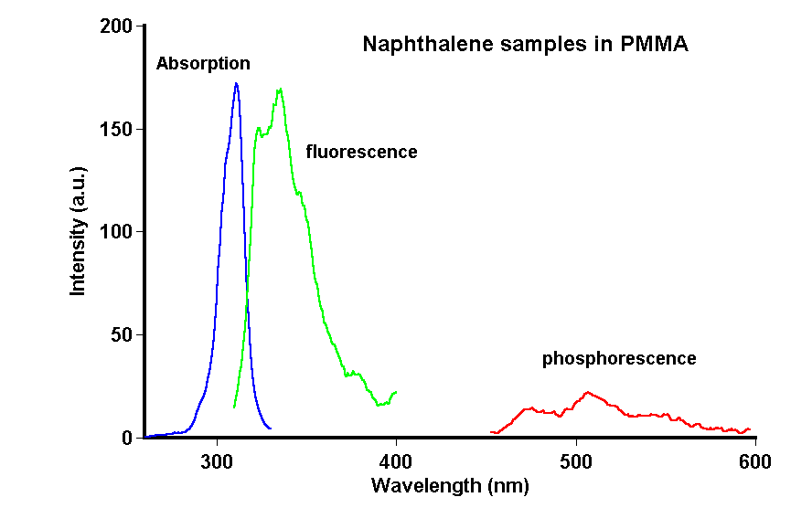
Absorption, Excitation, and Emission Spectra
Absorption and Excitation
Absorption spectra are often, but not always the same as excitation spectra
Emission is at longer wavelengths than excitation
Stokes Shift = difference between excitation and emission maxima
Phosphorescence is much weaker than fluorescence
Phosphorescence has a MUCH greater Stokes Shift than fluorescence.

Slide 28
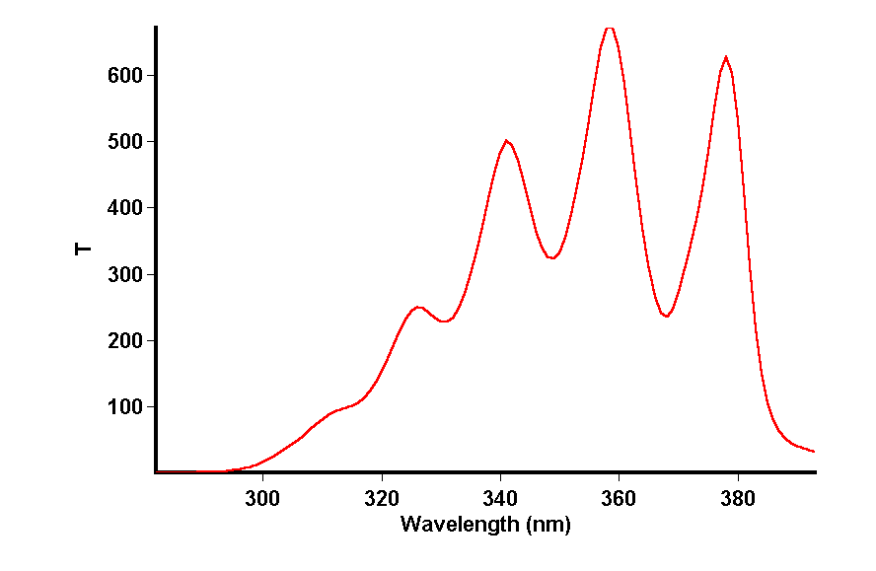
Excitation Scan
Light source
Sample
Monochromator
λ
excitation
Fix emission monochromator and
scan excitation monochromator
Result is
A fluorescence excitation spectrum
λ
emission
Monochromator
Detector

Slide 29
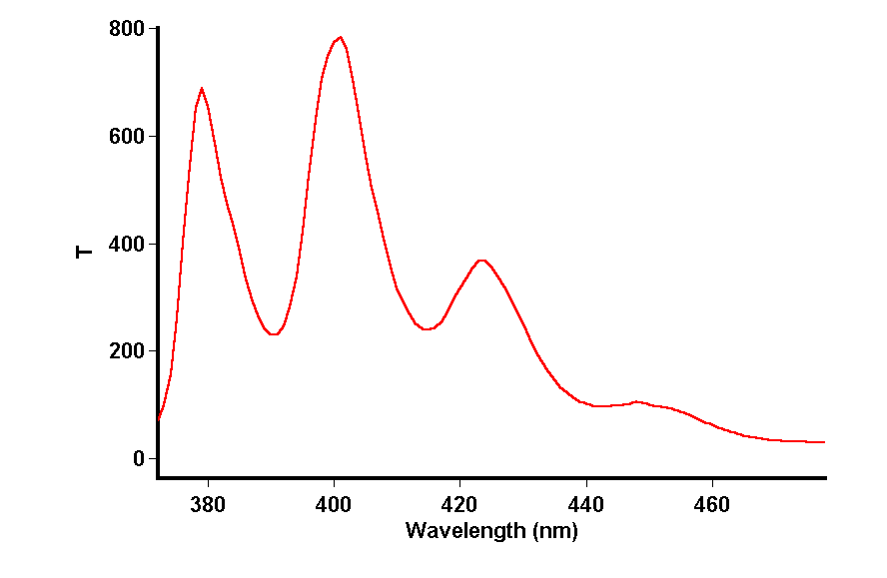
Emission Scan
Light source
Sample
Monochromator
Fix excitation monochromator and scan emission monochromator
Result is the fluorescence emission spectrum
λ
excitation
λ
emission
Monochromator
Detector

Slide 30
What information can we get from an Emission spectrum?
Information on molecular structure and fluorescent moieties
Local environment surrounding molecule being probed
Usually, the shape of the fluorescence spectrum is independent of the excitation wavelength
Emission spectrum is often a “mirror image” of the excitation spectrum

Slide 31
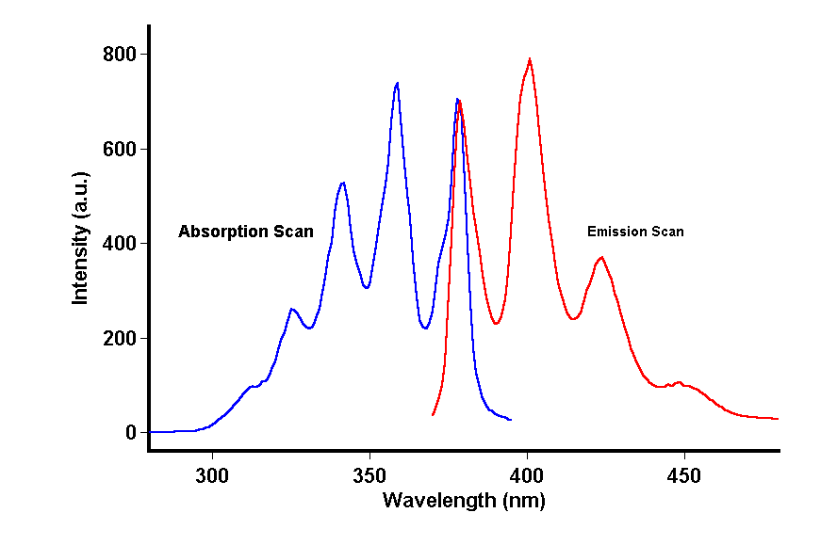
Fluorescence of Anthracene
Excitation
Emission

Slide 32
Scattering Artifacts in a Fluorescence Spectrum
Fluorescence or Scatter…how can you tell?

Slide 33
Types of Scatter
RAYLEIGH
elastic scattering
energy of scattered light = energy of excitation
RAMAN
inelastic scattering due to solvent
energy of scattered light < energy of excitation

Slide 34
Identifying Rayleigh vs. Raman Scattering
RAYLEIGH (1st and 2nd Order)
If λ_{scatter} = λ_{ex} 1st order
If λ_{scatter} = 2λ_{ex} 2nd order
Most apparent in solids and highly scattering solutions
RAMAN
If λ_{scatter} > λ_{ex}
Raman
EASY TO IDENTIFY RAYLEIGH!
But fluorescence is also > λ_{ex} …Right???

Slide 35
Identifying Fluorescence vs. Raman (in solution)
Qualitative Method
Observed peak is likely Raman if:
Peak shifts to longer λ as the λ_{ex} is increased
Peak also appears in the spectrum of the blank
Run emission scans at different λ_{ex} for both sample and blank!

Slide 36
Identifying Fluorescence vs. Raman (in solution)
Quantitative Method
Calculate the Raman band for the solvent at the λ_{ex} used
For water:
λ_{RAMAN} = λ_{ex} / (1 – 3.39 x 10⁻⁴ λ_{ex})
If λ_{ex} = 300 nm then λ_{RAMAN (in water)} = 335 nm
If λ_{ex} = 350 nm then λ_{RAMAN (in water)} = 397 nm
(The 3.39 x 10⁻⁴ nm⁻¹ is a the Raman shift specific to water…use 2.92 x 10 ⁻⁴ and 1.43 x 10 ⁻⁴ for ethanol, 2.87 x 10 ⁻⁴ for cyclohexane).

Slide 37
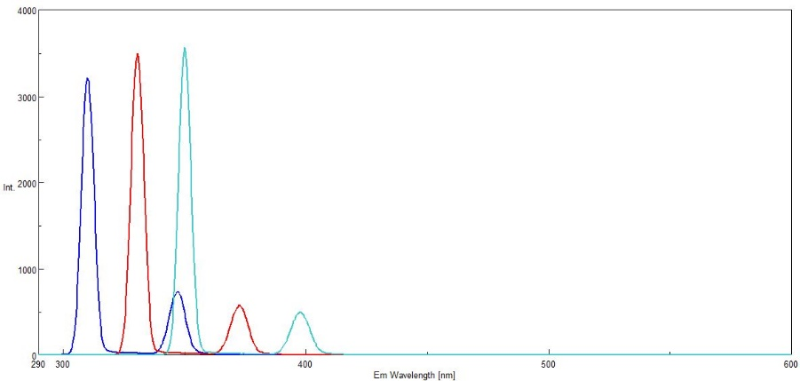
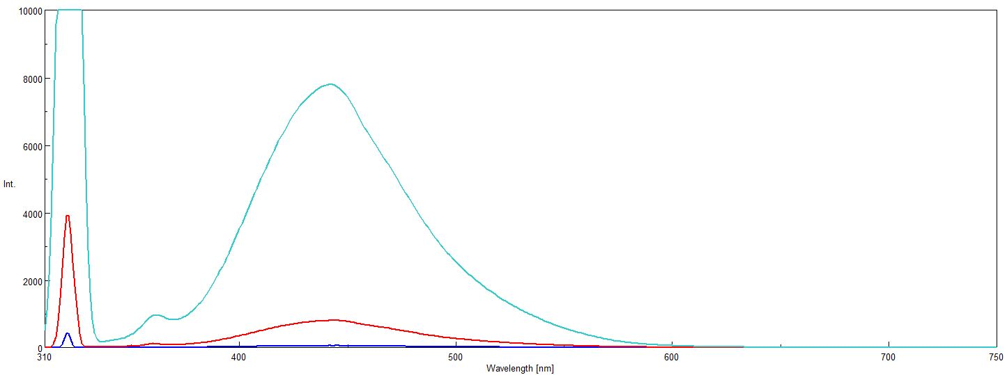
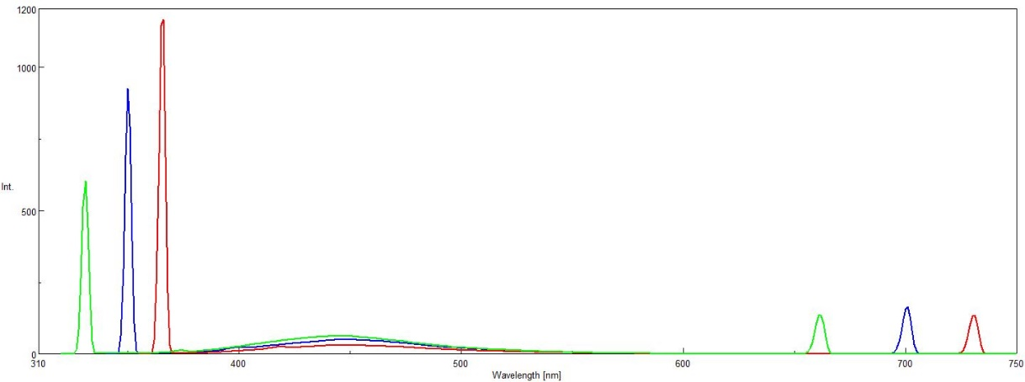
Optimizing Fluorescence: Examples in Spectra

Slide 38
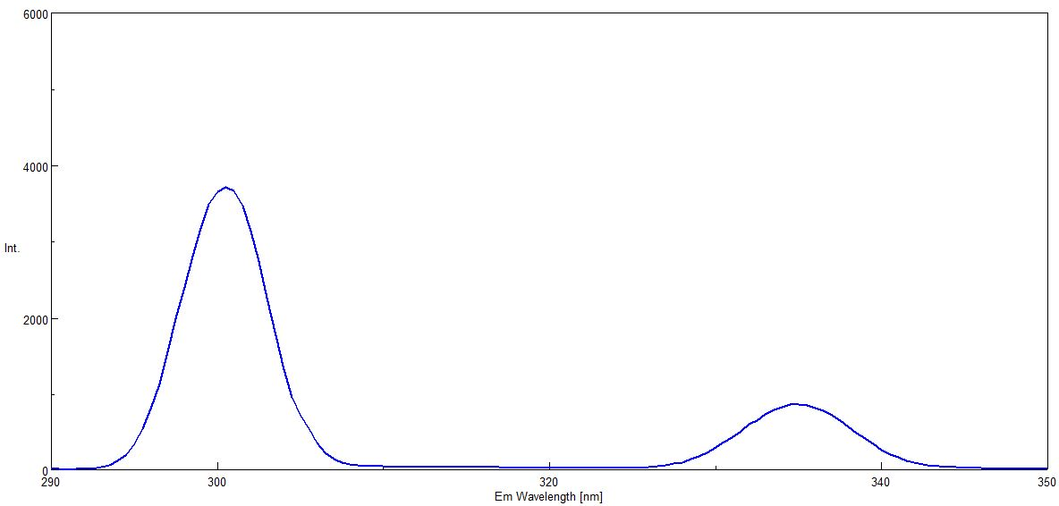
Scatter in Water λ_{Εx} = 300 nm
300 nm
RAYLEIGH
SCATTER
λ = λ_{Εx}
335 nm
RAMAN
λ > λ_{Εx}

Slide 39
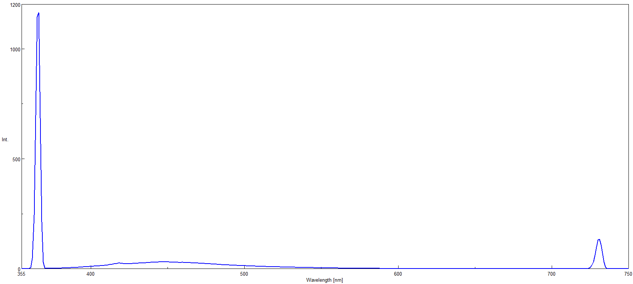
Cranberry Juice: Diluted λ_{Εx} = 365 nm
365 nm
RAYLEIGH
SCATTER
λ = λ_{Εx}
2nd ORDER RAYLEIGH
SCATTER
λ = 2λ_{Εx}
RAMAN or FLUORESCENCE??
λ > λ_{Εx}
730 nm
450 nm

Slide 40
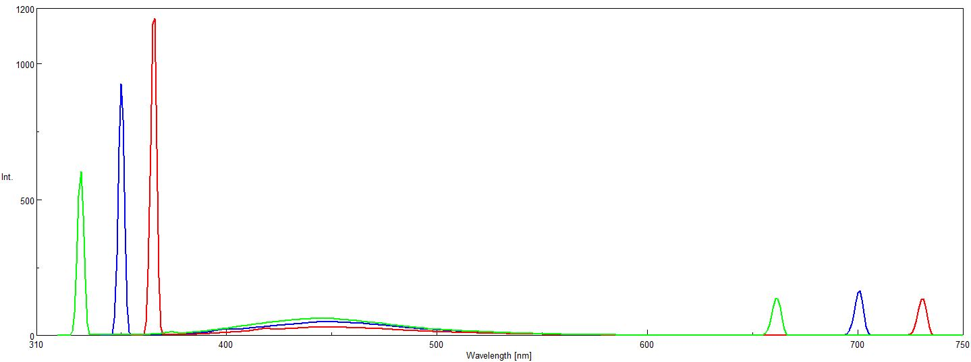
Cranberry Juice: Decreasing λ_{Εx}
λ_{Εx} = 365 nm
λ_{Εx} = 350 nm
λ_{Εx} = 330 nm
Moving λ_{Εx} to shorter λ
Shifts band to shorter λ

Slide 41
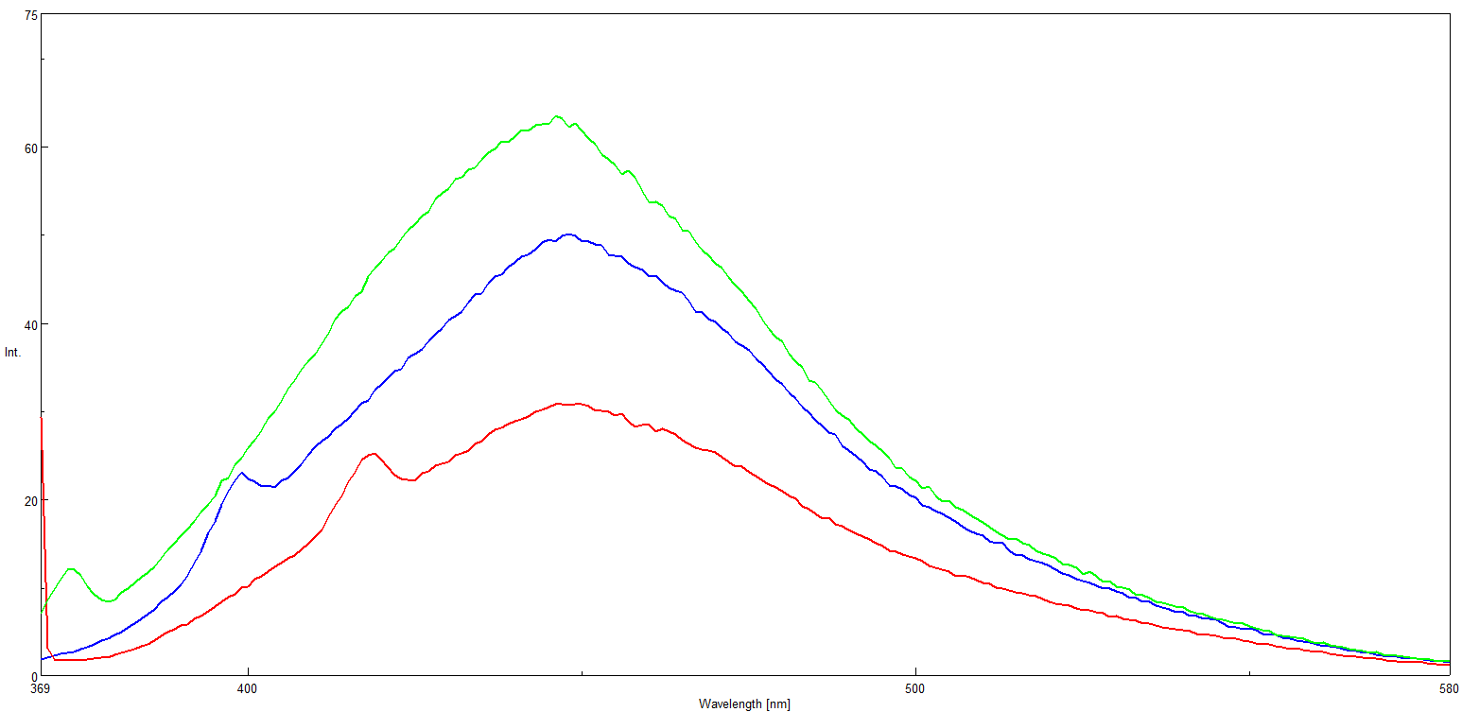
Cranberry Juice: Fluorescence?
Band at 450 nm only changes in intensity
Must be fluorescence!
Band at shorter λs shifts with Δ in λ_{Εx}
Must be Raman!
λ_{Εx} = 365 nm
λ_{Εx} = 350 nm
λ_{Εx} = 330 nm
??
450 nm

Slide 42
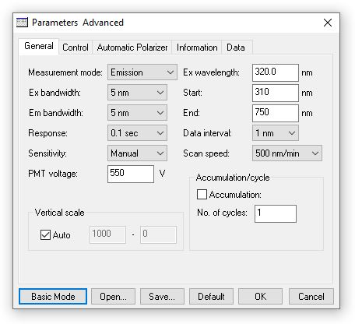
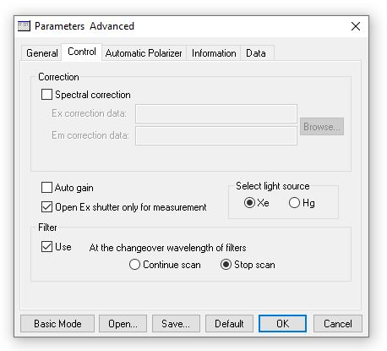
Instrument Parameters
λ_{Ex ,} λ_{Em}
Slits / SBW
Detector HV
Internal Filters

Slide 43
Cranberry Juice: Different Spectral Bandwidths (SBW)
SBW F
10 nm 7800
5 nm 800
2.5 nm 51

Slide 44
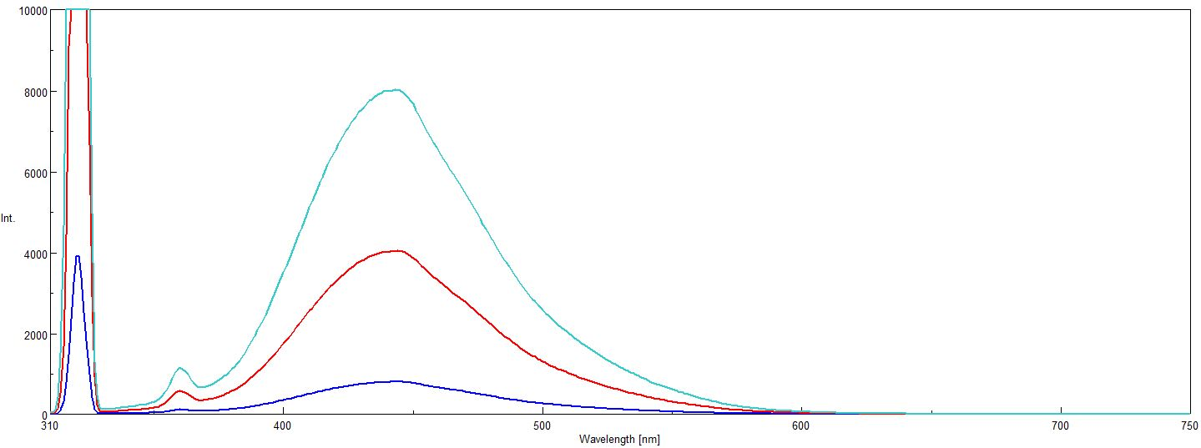
Cranberry Juice: 5nm SBW at Different Detector Voltages
Detector F
550 V 8000
500 V 4000
400 V 800

Slide 45
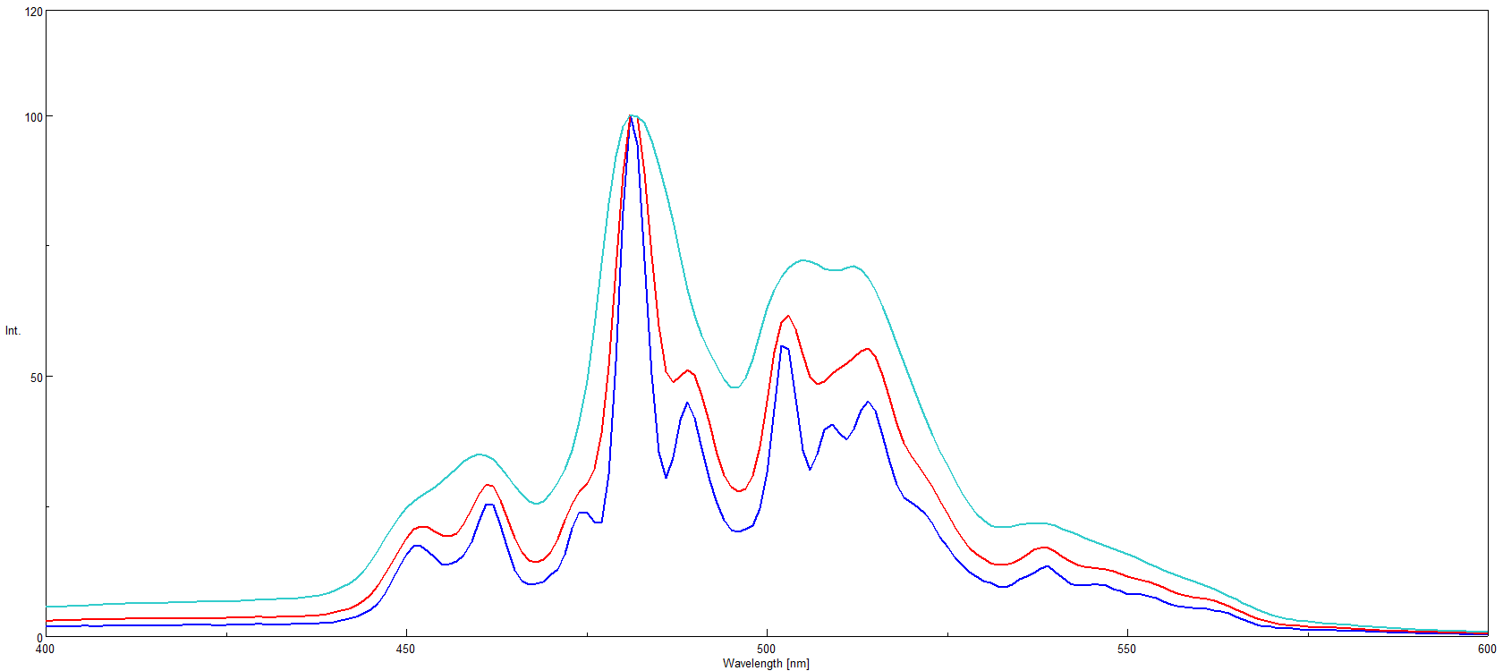
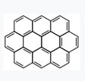
Spectral Bandwidth and Resolution
SBW
10 nm
5 nm
2.5 nm
SBW Resolution
Ovalene

Slide 46
Quantitative Fluorescence and Inner Filtering Effects

Slide 47
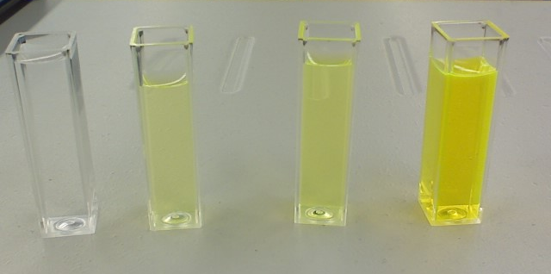
Which one has the greatest fluorescence signal?

Slide 48
Which one has the greatest fluorescence signal?
F
Concentration

Slide 49
Concentration Effects: High [ ]’s
Recall from F = 2.303 K I_{o} εbc
Factors which F as c:
Self (concentration) quenching
Formation of new species after absorption
Energy transfer
Inner filtering effects

Slide 50
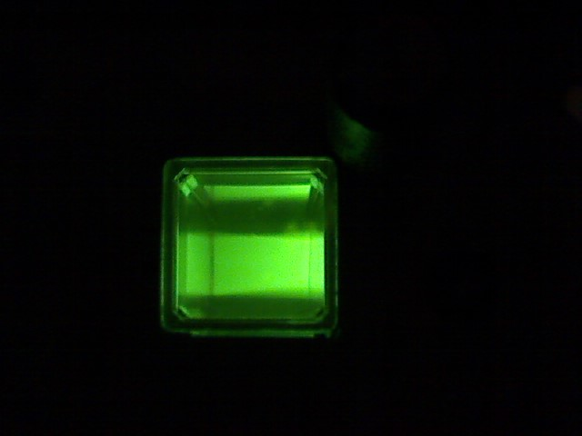
Excitation in a Cuvette: A View from Above
EX
EM

Slide 51
Typical Fluorescence: A Cuvette View
Green Excitation
penetrates all the way across cuvette
Red Fluorescence is seen across entire
emission face
NO INNER FILTERING!!!
EX
EM

Slide 52
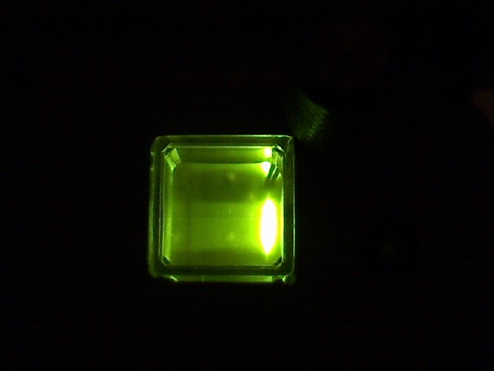
Primary Inner Filtering View In a Cuvette
EM
EX

Slide 53
Inner Filtering: A Cuvette View Primary Absorption
Green excitation light does not penetrate
across the full width of the cuvette.
More concentrated solution BUT
much less fluorescence because
most of molecules are not excited.
PRIMARY ABSORPTION occurs before the
emission of a photon of light.
EX
EM

Slide 54
Inner Filtering: A Cuvette View Secondary Absorption
Some of the shorter emitted λ’s are reabsorbed
Emission signal is attenuated at shorter wavelengths
which produces an apparent red shift
SECONDARY ABSORPTION results from
overlap of λ_{ex} and λ_{em} for the fluorophore
Occurs in fluorophores with a narrow Stokes Shift
EX
EM

Slide 55
How to Minimize Inner Filtering
Use more dilute solutions
Try to work in linear range!
Keep Abs < 0.005 at maxima for both λ_{ex} and λ_{em}
Try a shorter pathlength cuvette
Use front face illumination (triangular cells)

Slide 56
Take-Home Message 2: Parameters for Fluorescence Optimization
Careful compromise of instrument settings for best signal:
Wavelength Selection for λ_{Ex} and λ_{Em}
Exclude scatter to maximize sample signal
Identify and move Raman band way from peaks of interest
Filters for excitation and emission channels
USE filters to minimize 2nd order scatter
May need additional external filters
PMT detector sensitivity (V)
Find detector voltage V that enhances signal with least noise
Slit Widths or Spectral Bandwidth (SBW)
Find SBW that provides desired combination of
signal and resolution, minimizing noise
RULE of THUMB:
sum SBW for ex/em slits < Stokes Shift (λ_{Em} – λ_{Ex})

Slide 57
Thanks for joining us!! Questions?

Slide 58
JASCO Educational Resources
Upcoming Webinars:
Circular Dichroism
Vibrational Circular Dichroism
FTIR Theory, Instrumentation, and Techniques
FTIR Microscopy
Raman Microscopy and Imaging
SFC Theory and Applications
E-books and/or Tips and Tricks Posters
Raman
Fluorescence
FTIR
CD
KnowledgeBase
NEXT WEBINAR WILL BE ON
CD THEORY AND APPLICATIONS
DR. LEAH PANDISCIA
TUESDAY APRIL 14TH AT 2:00 PM EDT

