Slide 1
Raman Theory and Instrumentation
Dr. James Burgess

Slide 2
About JASCO
Founded in 1958 by Yoshio Fujioka and Shinichiro Tomonaga (Nobel Prize winner, QED).
US Application Scientists:
6 PhD Scientists
2 Vibrational Spectroscopists
Notes:
JASCO has been around for over 60 years. In the US we have 4 PHD applicaattion scientists including 2 vibrational spectroscopists. Sorry we missed you

Slide 3
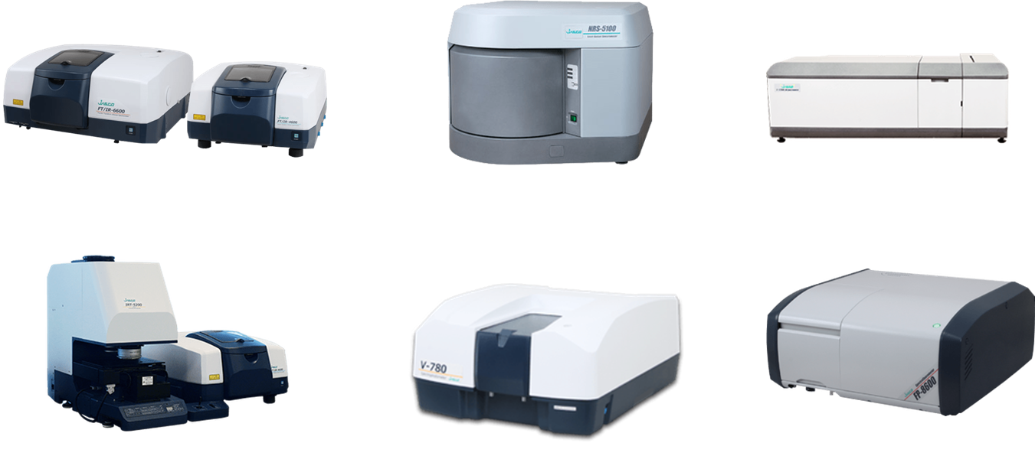
JASCO Spectroscopy Expertise
FT/IR
Raman Microscopy
ECD/VCD
IR Microscopy
UV-Vis
Fluorimetry

Slide 4
Some Raman Examples

Slide 5
Uses for Raman – Chemical Identification

Slide 6
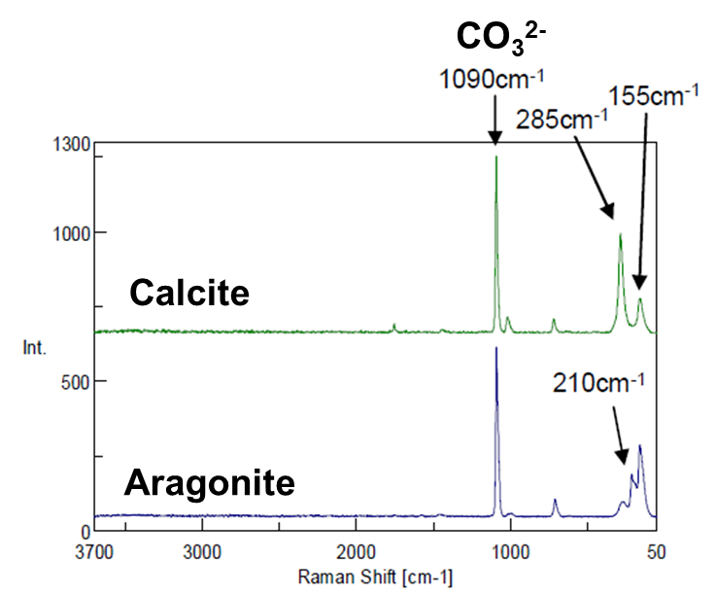
Uses for Raman – Polymorph Analysis

Slide 7
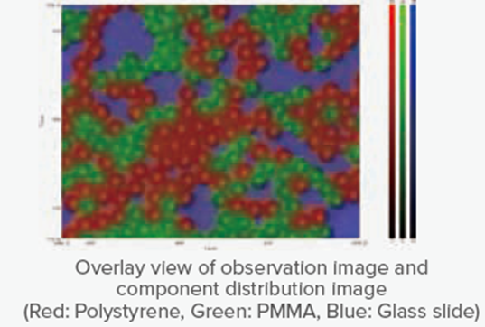
Uses for Raman – Chemical Compositional Mapping

Slide 8
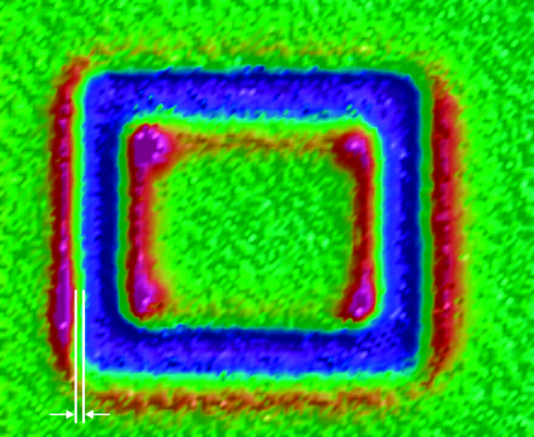
Uses for Raman – Strain Analysis

Slide 9
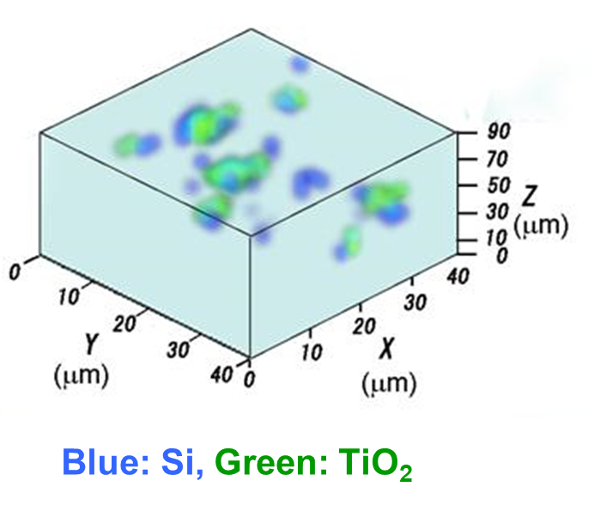
Uses for Raman - Depth Profiling

Slide 10
Raman Theory

Slide 11
Electromagnetic Spectrum
Photon energy is directly proportional to frequency and inversely proportional to wavelength
E
E = hν = hc/λ
Notes:
The infrared region lies between the Microwave and Visible portions of the spectrum. Units for FTIR typically are cm⁻¹ (wavenumbers) which is proportional to energy according to the following equations. ‘h’ and ‘c’ are Plank’s Constant and the speed of light, respectively.

Slide 12
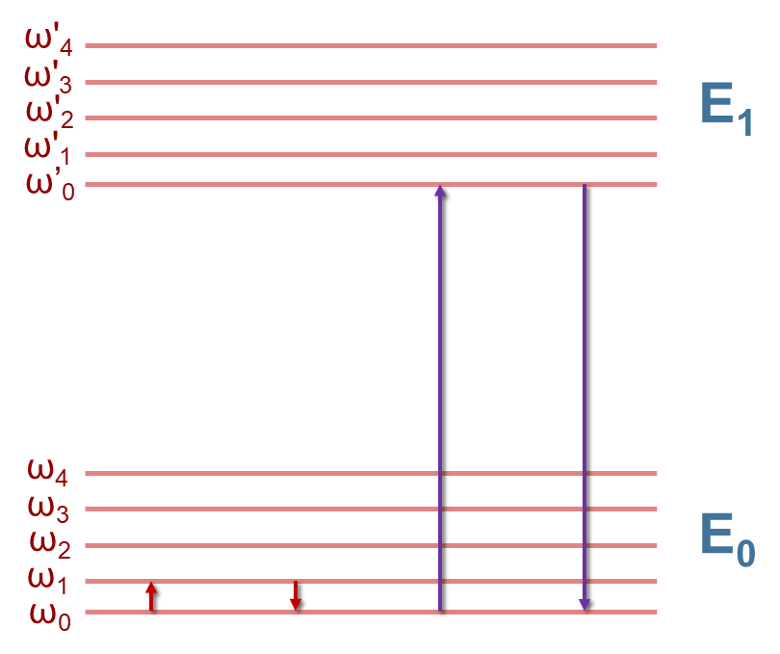
Infrared And Electronic Transitions
Infrared (Vibrational) transitions, ω.
UV-Vis (Electronic) transitions, E.
Energy
E = h. v
c = λ/ v
Notes:
Infrared (Vibrational) transitions are at a much lower energy (longer wavelength) than UV-Vis. The transition energies (say ω₀ -> ω₁ or E₀ ->E₁) are directly proportional to frequency and inversely proportional to wavelength.

Slide 13
Laser Virtual States
ω'₄
E₅₃₂
ω'₃
E₁
ω'₂
Lasers create virtual states.
When the laser is in E1, fluorescence may occur.
ω'₁
ω’₀
E₇₈₅
Energy
E₁₀₆₄
ω₄
ω₃
E₀
ω₂
ω₁
ω₀
Notes:
Lasers create a virtual state whose energy is inversely proportional to the laser wavelength. Generally, and this depends on sample, the following cases occur:
1064 falls between energy levels for most samples
785 falls close to the lowest excited state
<785 nm is in the electronic E₁ energy state
If there is a fluorophore present <785 will cause fluorescence.

Slide 14
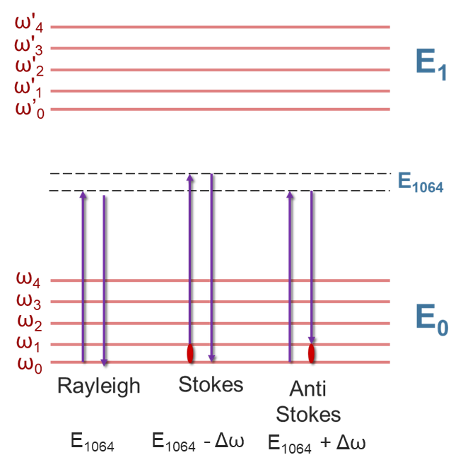
The Raman Effect
Raman uses electronic transitions to measure infrared energy levels!
Energy
Notes:
The previous figure showed Rayleigh scattering of the incident light, also known as elastic scattering. The light does not gain or lose energy. This is the result of most of the interaction between light and matter. However light can also undergo inelastic scattering and gain (antistokes) or lose (stokes) energy in collision. These interactions are rare (1:1,000,000) and require a large number of photons to be measurable, hence the use of lasers in the technique

Slide 15
Fluorescence – Competing Event
ω'₄
E₅₃₂
ω'₃
E₁
Fluorescence can be a competing event to Raman.
The transitions are 1000 times greater than Raman.
ω'₂
ω'₁
ω’₀
Energy
ω₄
ω₃
E₀
ω₂
ω₁
ω₀
Raleigh
Raman
Fluorescence
Notes:
The main enemy to IR is water; the main enemy of Raman is fluorescence. Flourescence occurs when electrons are promoted into the excited vibrational state of an excited electronic state. The result is a relaxation of energetic states which emits a photon of lower energy than the excitation photon. The resulting photon “competes” with the lower energy photons in Raman. We’ll circle back to this later in the talk.

Slide 16
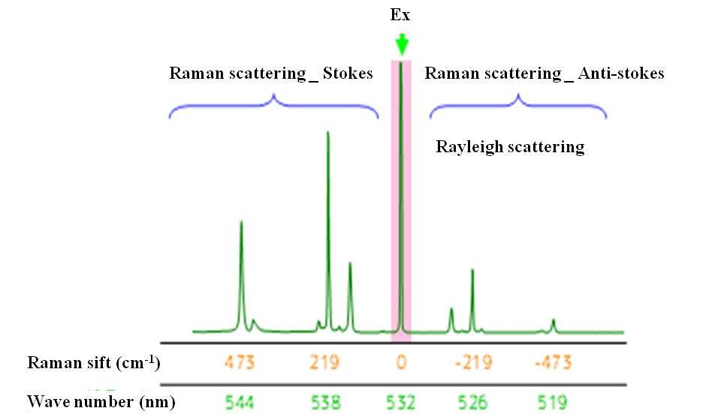
Raman Spectra
Raman Shift (cm⁻¹)
-473
-219
0
219
473
Wavelength (nm)
519
526
532
538
544
Notes:
Here we have a typical Raman spectra showing the three main features, stokes shift, Raleigh scattering, and the anti-Stokes shift. Note that the Stokes shift occurs at lower energy level as the Raleigh line.

Slide 17
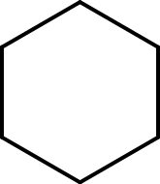
Raman/FTIR Cylcohexane

Slide 18
Infrared Modes - Change in Dipole Moment
H
H
C
O
C
O
H
H
Notes:
Most people are more familiar to FTIR than Raman, so I’ll take a moment for IR transitions just to compare to Raman. Infrared energy causes a shift in a molecule’s dipole moment. This change in dipole moment causes a vibration of a molecule.

Slide 19
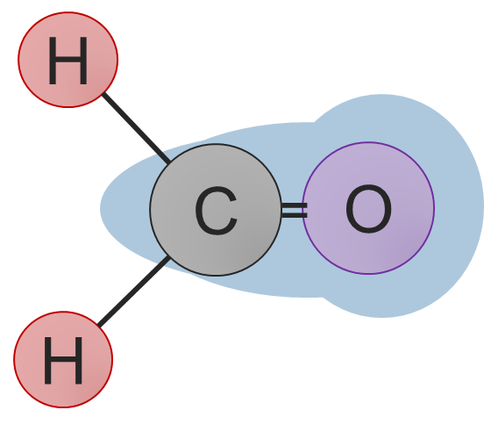
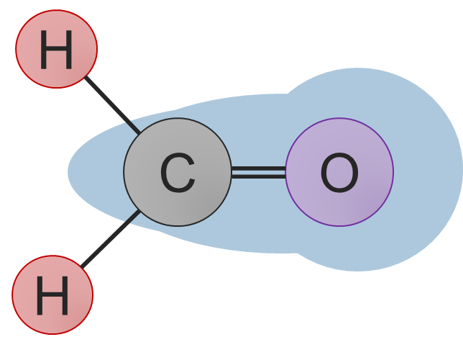
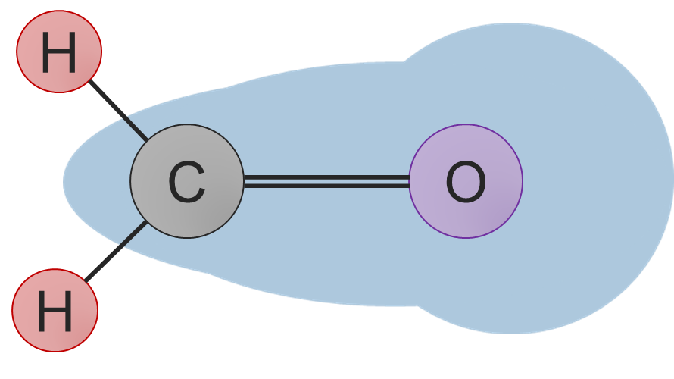
Raman Modes-Change in Electron Cloud (Polarizability)
q⁺
q=0
q⁻
Displacement (q) of atoms in a molecule during a C=O vibration.
Notes:
Let’s look at the electron cloud during that same vibration. The shape of the electron cloud changes during the vibration. The displacement of the molecules during vibration is q+, q=0 is equilibrium, q-.

Slide 20
Raman Modes-Change in Electron Cloud (Polarizability)
Displacement (q) Versus Polarizability (α)
α⁺
q⁺
q=0
q⁻
q⁺
q⁻
Vibrational modes are Raman active if the displacement of the atoms (q) result in a change in the electron cloud (polarizability,α).
α₀
α⁻
Notes:
Raman can cause the same vibration using a different route. Sometimes when a molecule’s electron cloud is excited it can cause a vibration. The energy of this excitation is on the same order of magnitude as IR, but occurs because the polarizability (how easy it is to change the electron cloud) changes over the course of the vibration.

Slide 21
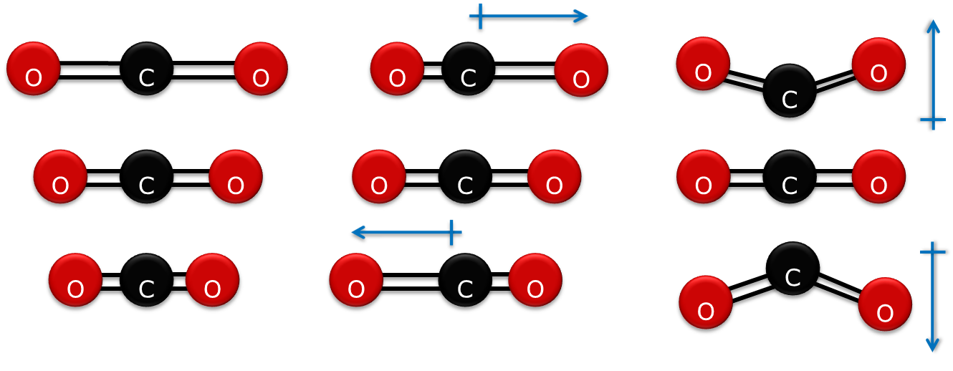
CO₂ Vibrational Modes
Symmetric
Asymmetric
Bending
Number of Modes:
Linear: 3N-5
Nonlinear: 3N-6
Selection Rules (Why peaks appear):
IR needs a net change in Dipole Moment
Raman needs a net change Electron Cloud Position
IR
Raman
IR
Raman
IR
Raman
Notes:
Let’s take a look at the IR/Raman modes of a molecule. CO2 is a simple molecule that has only three modes: Symmetric Stretch, asymmetric stretch, and bending. Note that the larger the molecule, the higher the number of possible modes (formaldehyde has 6 possible modes). There is no change in dipole moment but change in polarizability for the symmetric stretch, meaning it is IR inactive but Raman active. There is no net change in polarizability and a change in dipole moment, resulting in no Raman signature and an IR signature. What do you think will happen for the bending mode.

Slide 22
CO₂ Vibrational Modes
Symmetric
Asymmetric
Bending
Selection Rules (Why peaks appear):
IR needs a net change in Dipole Moment
Raman needs a net change Electron Cloud Position
IR
Raman
IR
Raman
IR
Raman
Notes:
Like the asymmetric stretch, there is no net change in polarizability and a change in dipole moment

Slide 23
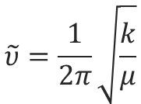
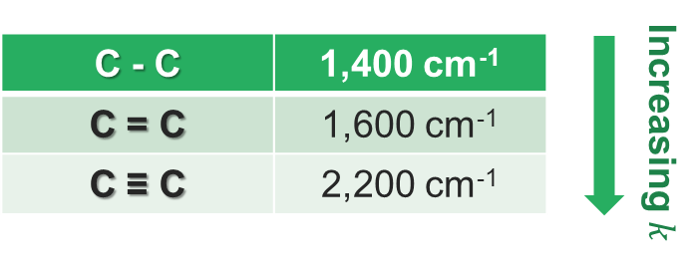
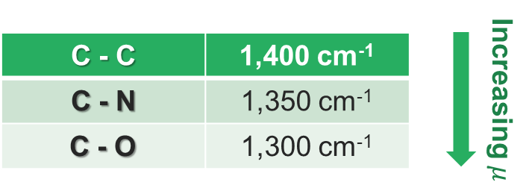
Bond Strength, Mass, and Wavenumbers
Vibrational energies are dependent on bond strength (k) and reduced mass (μ). Generally, increasing bond order leads to increasing energy, and increasing mass leads to decreasing energy.
Notes:
The exact energies of vibration are directly proportional to the spring constant of the bond while inversely proportional to the reduced mass. How the spring constant affects energy is shown to the left. How the reduced mass affects energy is shown on the right. As can be seen, the type of bond affects the energy more than reduced mass.

Slide 24
Correlation Table
Notes:
Correlation charts for IR work for Raman as well, since the energy for vibration is similar between measurements as long as the mode is Raman active for a molecule. A caveat to this: in general, if a mode is strongly active (intense) in IR then it is weak in Raman, and vice versa.

Slide 25
Raman Vs. IR
While they give similar information, they have inherent differences.
 | IR | Raman
Organic Molecules | Yes | Yes
Inorganic | Yes | Yes
Aqueous | Difficult | Yes
Concentration | <100 ppb | >10 ppt
Microscope | Yes | Yes
Fluorophores | Yes | Difficult
Notes:
Raman and IR are known as complementary techniques because they give complete vibrational information. In general if a peak does not appear in IR, it will appear in Raman. This table lists a comparison of the two techniques (preferred in bold). While both can distinguish organic molecule bonds, IR has a slight edge due to the hydrogen bond vibrations being weaker/nonexistent in Raman. Most inorganic bonds such as metal-oxygen bonds are highly Raman active and occur in what is known as the Far-IR region, requiring special FTIR instrumentation. Water absobs strongly in IR, but not at all in Raman, allowing for measurement in aqueous solutions. The LOD for Raman is not as low since Raman transitions are weak. Both can be used in microscopy, with Raman have better spatial resolution. Molecules with fluorophores are easier to examine with FTIR.

Slide 26
Raman Optical Configuration
NRS Hardware
Notes:
From here we shift from theory to the hardware that makes measurement possible.

Slide 27
Raman Optical Configuration
Notes:
Here is a schematic for a typical Raman set-up. We will touch upon each in function and options. In general we will talk about lasers, rejection filters, gratings, and detectors.

Slide 28
How Lasers Work
Pumping
Spontaneous Emission
Stimulated Emission
Diode-pumped solid-state lasers(DPSS) use a photodiode for pumping.
Notes:
The flash tube creates photons to irradiate the lasing material (ruby). The photons are first absorbed in spontaneous emission, the lasing material undergoes fluorescence, meaning the light is relaxed and emitted with the same energy regardless of excitation energy. These photons are incoherent. During the stimulated emission stage, the photons do not undergo fluorescence and are coherent (same direction). Two mirrors are at either end of the lasing material: a non-transparent and a slightly transparent mirror. Light at high intensity exits the transparent window.

Slide 29
Laser Options
Notes:
The laser acts as the source of the instrument and provides the virtual energy state we discussed earlier. Possible lasers range from the UV to the Near IR. Each has its advantages and disadvantages. The higher the energy, the more intense the Raman signature, but the greater the instance of fluorescence.

Slide 30
Fluorescence Avoidance By Laser Type
Notes:
An example of using the right laser for the right sample is the problem of fluorescence. Four lasers were used to study a molecule with a fluorophore. As you can see the 532 laser signal is swamped by fluorescence, while as you go up in wavelength flouresence is minimized further and further until at 1064 it is completely eliminated.

Slide 31
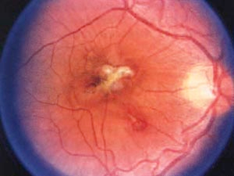
A Note About Laser Safety
A human eye can see ~390 – 700 nm. Higher or lower energy cannot be seen, causing a two-fold problem:
Cannot know location/state of the laser.
Dilated pupils gather more light, causing more damage.
Without laser safety enclosure Class 3B– not compliant independently. Require:
Laser safety training for all users.
Special signage for laboratories.
Laser Safety goggles.
With laser safety enclosure: Class 1– EHS complaint.
Safety interlocks in enclosure prevent active lasing while the cover is open.
2004 LANL - undergraduate lab accident – accidental YAG laser exposure – Retina image.
Notes:
The lasers used for Raman have a high intensity and can cause severe eye damage. The image to the right is a retinal image of an undergraduate after an accident with a 1064nm YAG laser. The human eye can see from 390-700nm, meaning light of higher or lower wavelength cannot be seen. Consequently one cannot know the state of the laser and widened pupils allow more light to the retna. Without a safety enclosure a laser is class 3B and requires laser safety training, special signage, and laser goggles for everyone in the lab, not just the users. With a safety enclosure and interlocks, it is considered Class 1 and does not need additional safety measures.

Slide 32
Calibration – Neon Lamp or Polystyrene Internal Standards
Since Raman measures the difference between the incident radiation (laser) and Stokes shift wavelengths, response linearity and laser peak position are important for spectral resolution and wavenumber accuracy. A 0.1 nm shift is about 4 cm⁻¹
For a routine check a polypropylene, silicon, or diamond standard can be used. Calibration standards need to have a sharp, well defined peak.
Internal Neon lamp gives multiple spectral lines to calibrate the signal. For true calibration you need 3+ data point (5 ideal).
Notes:
Calibration of Raman instruments is important because a small shift in the laser’s wavelength (1nm) can have a large effect on Raman peak position (40cm⁻¹). For a routine check polypropylene, silicon, or diamond may be used since they have sharp, well-defined peaks. For a true calibration using multiple sharp, intense lines the spectral lines of a neon lamp may be used.

Slide 33
Raman Optical Configuration
Notes:
Here is a schematic for a typical Raman set-up. We will touch upon each in function and options. In general we will talk about lasers, rejection filters, gratings, and detectors.

Slide 34
Objective Lens Selection
NA stands for numerical aperture and related to the angle of incidence of the beam waist.
Different objectives collect a different amount of light.
Since Raman is a weakly scattering technique high NAs are desirable.
Notes:
Since Raman uses visible light, normal visible optics may be used. A caveat is that Raman is a weak scattering effect and thus high NA objectives should be used. If you look at the collection cones of a 20x SWD and LWD it becomes apparent that the collection angle is higher for the SWD is greater, giving a better Raman spectra. However there are applications where the LWD is needed, but expect weaker signal.

Slide 35
Beam Waist and Spatial Resolution
Spatial Resolution is dependent on both NA and wavelength.
Notes:
The beam size is dependent on laser wavelength and NA of the optics. The beam waist for a SWD objective with a high NA is almost the same as the wavelength of light. This will give you good spatial resolution in the x-y. The penetration depth is more dependent on NA than wavelength and is almost half the x-y. This is important for depth profiles.

Slide 36
Raman Optical Configuration
Notes:
Here is a schematic for a typical Raman set-up. We will touch upon each in function and options. In general we will talk about lasers, rejection filters, gratings, and detectors.

Slide 37
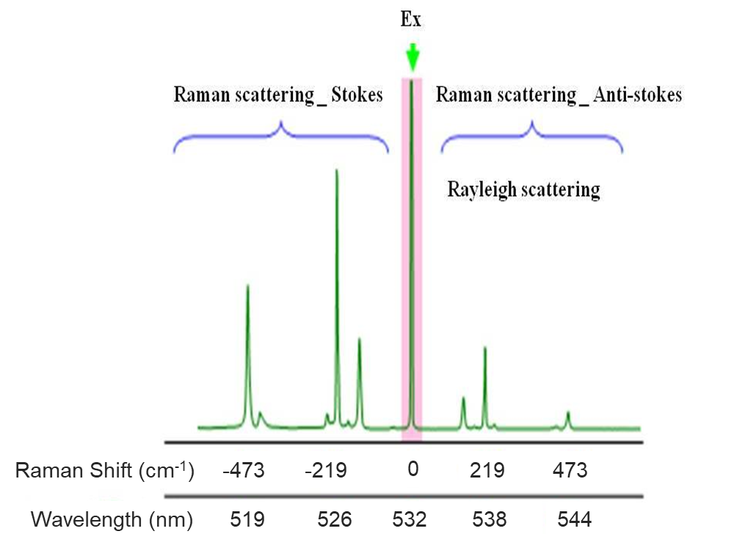
Filter Selection – Why Filters
Filters block light from the excitation source (laser) so not to overload the detector.
Each Wavelength requires it’s own filter.
Notes:
Next we’ll talk about rejection filters. Since the intensity of the laser >> than the intensity of Raman peaks, filters must be put in place to avoid damaging the detector.

Slide 38
Filter Selection
Edge Filter – Stokes transitions only. Higher intensity (>92%), higher wavenumber cut-off (100 cm⁻¹).
Notes:
Edge filters are the most common types of filters. They have a high intensity throughput and a cut-off of 100 cm⁻¹

Slide 39
Filter Selection
Low E Edge Filter - Lower intensity (>80%), Lower wavenumber cut-off (50 [down to 5 w/ 7500 opt] cm⁻¹).
Notes:
The low-e filter has a cut down to 5 cm⁻¹. These are for systems such as the RBM of CNTs where peaks are of low cm⁻¹. The downside is that it has a low throughput (8%).

Slide 40
Filter Selection
Notch Filter – Stokes and anti-Stokes transitions. Lower transmission (>80%), higher wavenumber cut-off (150).
Notes:
The notch filter allows one to see both the stokes and anti-stokes. The primary use of this is to look at the density of states from the ratio of s/as shifts. The downside is that it has the highest cutoff and a low transmission.

Slide 41
Importance of Filter Placement in Optical Path
Notes:
So when the beam is placed before the camera as a beamsplitter, the laser spot and the visual image may not agree. Even more, there is no way to change alignment.

Slide 42
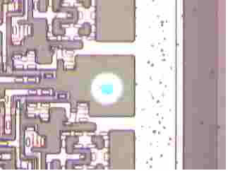
Simultaneous Observation of Laser Spot and Sample
Sample image
Aperture image
Laser beam

Slide 43
Raman Optical Configuration
Notes:
Here is a schematic for a typical Raman set-up. We will touch upon each in function and options. In general we will talk about lasers, rejection filters, gratings, and detectors.

Slide 44
Spectrograph
Czerny-Turner type
Notes:
Now we turn to the spectrograph. The most used is the Czerny-Turney type. This used a collimating mirror before the grating followed by a focusing mirror to the detector.

Slide 45
How a Grating Works
$$λ=d(\sin\left(i\right)+\sin\left(r\right))$$
r
i
Different wavelengths of light are reflected at different angles.
d
Notes:
A grating uses diffraction to separate wavelengths. When a broadband beam hits the grating at angle (i), it is undergoes diffraction with each wavelength of light reflecting at a different (r). The magnitude of spread is determined by the distance between grooves (d).

Slide 46
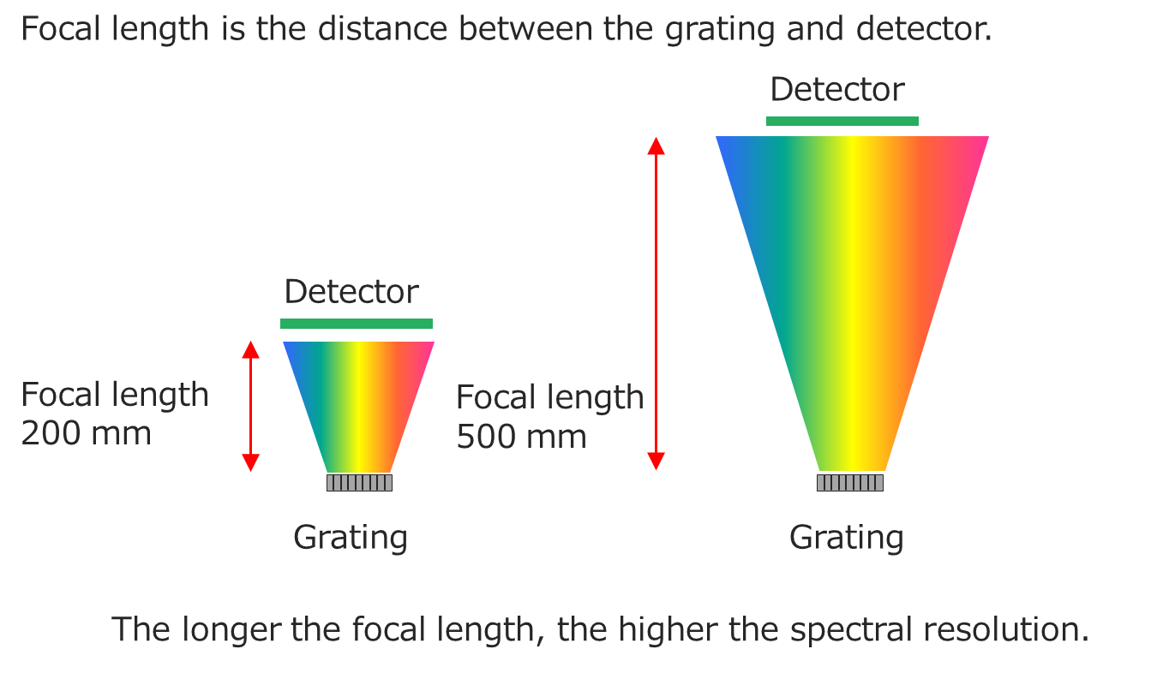
Focal Length and Resolution
$$λ=d(\sin\left(i\right)+\sin\left(r\right))$$
System | Focal Length | Resolution (Optional)
NRS-4500 | 200 mm | 2.0 cm⁻¹ (0.7 cm⁻¹)
NRS-5500 | 300 mm | 1.0 cm⁻¹ (0.7 cm⁻¹)
NRS-7500 | 500 mm | 0.7 cm⁻¹ (0.3 cm⁻¹)
Notes:
Since the light is radially spread, the distance between the grating and the detector impacts the resolution of the instrument.

Slide 47
Grating Selection
$$λ=d(\sin\left(i\right)+\sin\left(r\right))$$
Notes:
The number of grooves decreases d in the equation, increasing resolution, but decreasing wavelength range. This can be seen in the spectra on this slide. The widest range without moving the grating is the green spectrum from a 300 gr/mm grating and the smallest (red spectrum) is from a 2400 gr/mm grating. The trend in the bottom spectrum shows the resolution increasing from 300 to 2400 gr/mm.

Slide 48
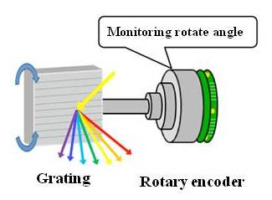
Rotary Encoding
Precise positioning of the spectrograph is important for wavenumber repeatability!
Notes:
Knowing the position of the grating as it rotates is very important for wavenumber reproducibility. An LED bulb is placed before a rotary panel with multiple slit patterns that are read with detection elements. This ensures that position is known more or less throughout the rotation of the grating.

Slide 49
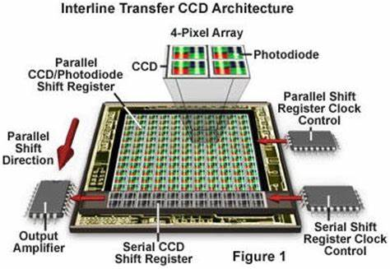
Detectors
CCD – Charge Coupled Device – converts photons to electronic signals
InGaAs – Converts Near IR wavelengths to electronic signal (used for 1064 nm).
EMCCD – Multiplies signal from CCD detector.
Diagram of a CCD device
https://hamamatsu.magnet.fsu.edu/articles/interline.html

Slide 50
CCD vs. EMCCD

Slide 51
Summary
Raman uses electronic (UV-Vis-NIR) light to probe vibrational (IR) energy levels.
Raman vibrations are the result of polarizability of a molecule.
Different selection rules give differences between Raman and IR spectra.
Lasers act as the Raman source with many possibilities on the market.
Rejection filters remove the laser line from the beampath.
Gratings determine the wavelength range and spectral resolution as it separates the light into different wavelengths.
Detectors such as CCD and InGaAs convert photons into readable electronic signals.

Slide 52
JASCO Educational Resources
Upcoming Webinars:
Vibrational Circular Dichroism
FTIR Theory, Instrumentation, and Techniques
Circular Dichroism
FTIR Microscopy
Raman Microscopy and Imaging
E-books:
Raman
Raman Tips & Tricks
Fluorescence
FTIR
Theory Page:
Confocal Raman Microscopy
KnowledgeBase

